Slide 1

Investment Data Visualization A case study using Tableau software
-AKSHAYA SHRIDHARR

Slide 2
LINEUP
To derive insights from the data provided by the client
Wireframe for Visualization and Dashboards.
Budget Estimation and POC
Problem Statements and respective Solutions

Slide 3
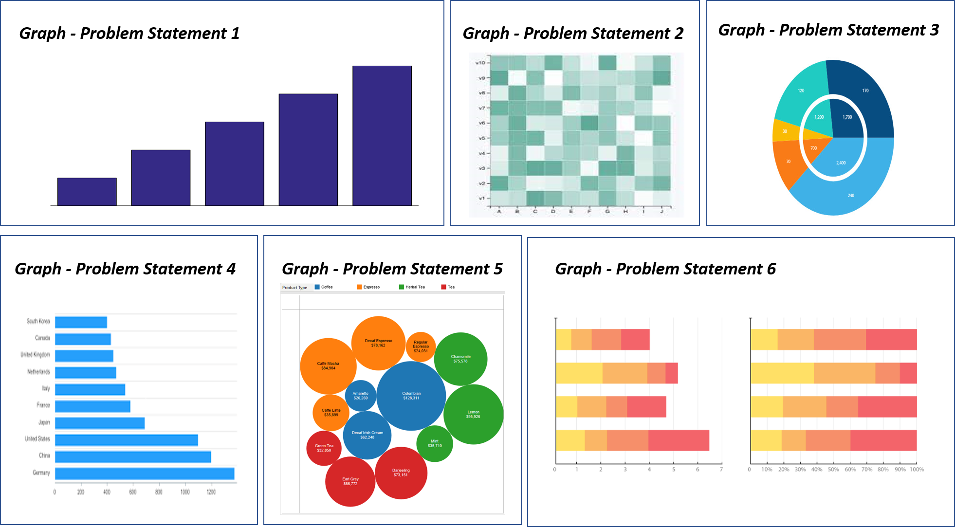
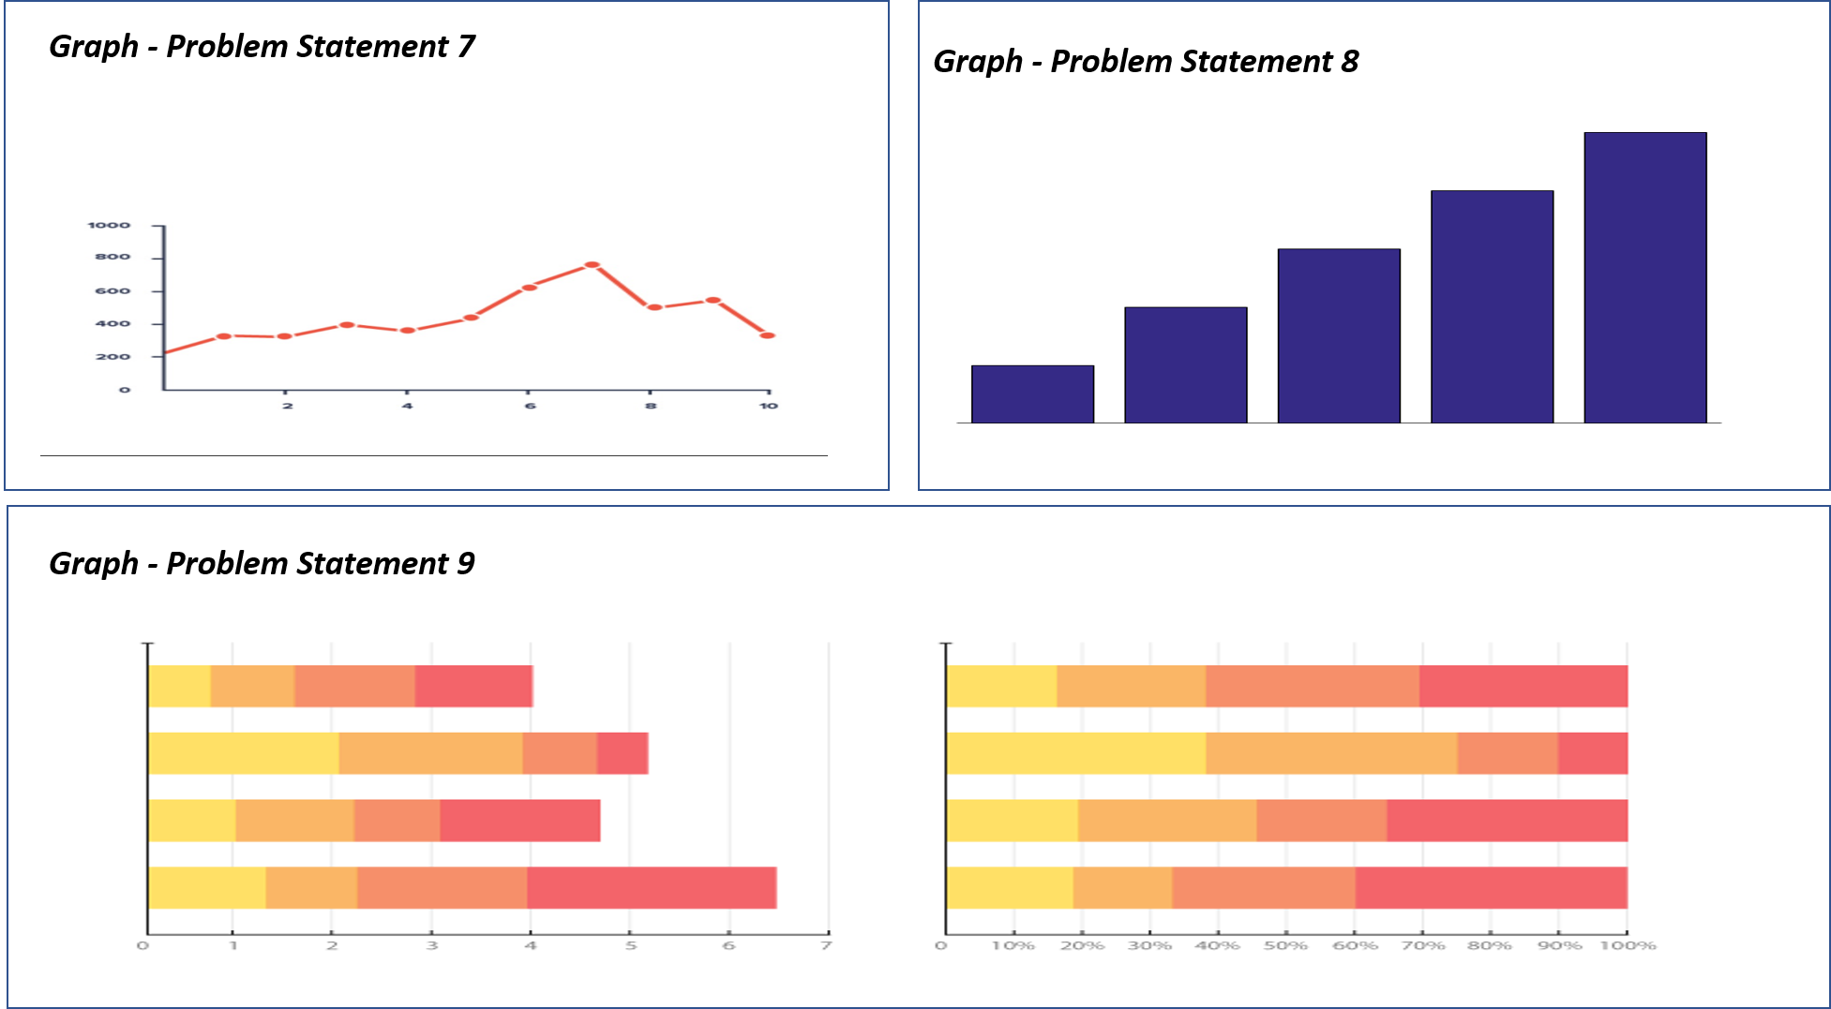
WIREFRAME FOR DASHBOARDS

Slide 4
BUDGET ESTIMATION AND POC
REQUIREMENTS AND ESTIMATE
Windows OS, Tableau Desktop – Available with designer
Data understanding and cleaning – 800 INR
Wireframe Design cost – 1500 INR
Tableau Creator Software - $70 per month (Approx. 5,100 INR)
Project cost per hour (Includes creating charts and finding insights) – 850 INR
Miscellaneous chargers – 500 INR

